Slide 1
Let’s go to the beach
Team Mango Bay

Slide 2
Motivation
Make going to the beach easy and safe
Protecting beach-goers from sunburns and HABs
Personal advices for each user
Educate the users with informative layers about the science of the UV index and how to prevent it’s rising

Slide 3
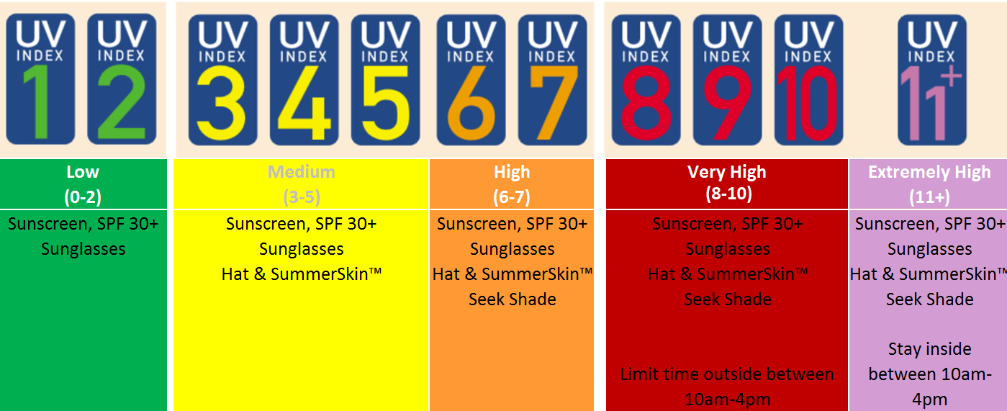
UV Index factors
Latitude
Altitude
Time
Month
Cloudiness

Slide 4
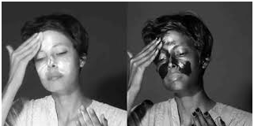
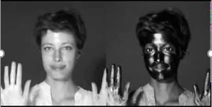
Sunburn factors
UV Index
Skin color
Clothes
Sunscreen

Slide 5
7.0 UV Index – Minutes to sunburn

Slide 6
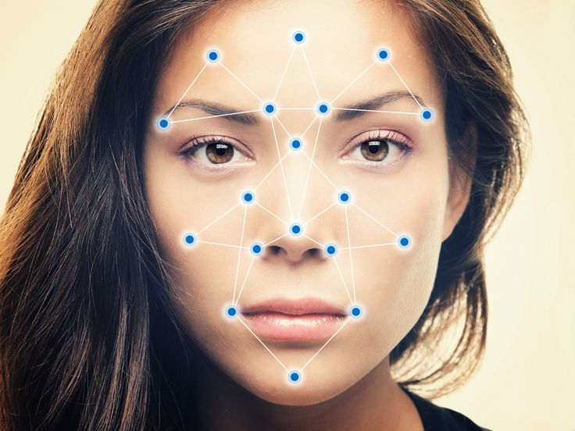
Personalization
Face detection:
Skin color: White
High sunscreen factor
Short time to sunburn
Protective clothing
Eye color: Light brown
Sunglasses preferred but not necessary

Slide 7
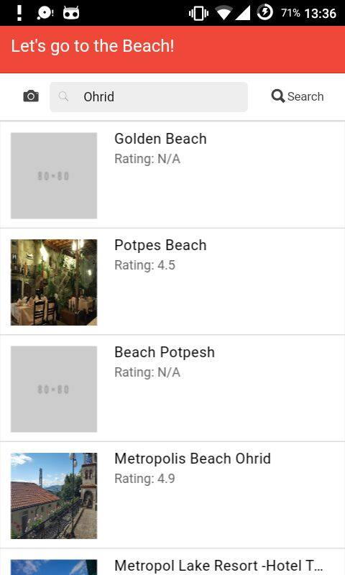
Location based beach recommendations
Choose which beach to visit based on:
Weather conditions
UV Index
HABs
Distance
Pictures
Rating

Slide 8
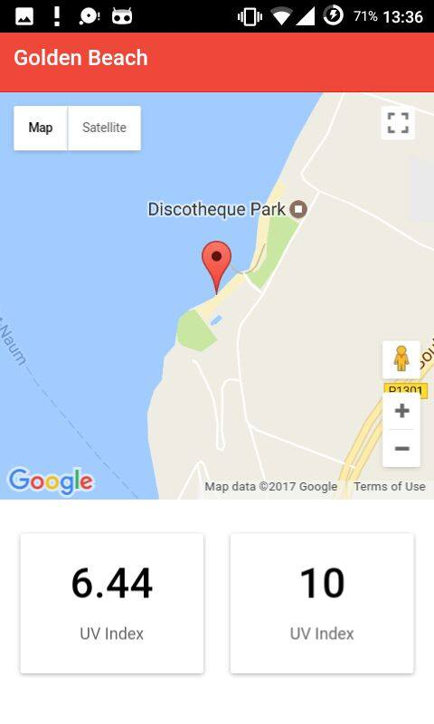
Personal advices
When to visit the beach
Which SPF to use
Maximum sun exposure
What to wear
Warnings about unexpected dangerous weather conditions
Cautions about harmful and unhealthy beach activities

Slide 9
Education
Straightforward and practical explanations of the UV Index science
Health tips
Skin cancer early detection and self exams
Protecting the ozone layers and the environment

Slide 10
Time for your questions

Slide 11
Thanks for your
Attention!

